Slide 1
Money and Inflation

Slide 2
http://www.youtube.com/watch?v=2NJnL10vZ1Y
Congressman Ron Paul questions Federal Reserve Chairman Ben Bernanke in a U.S. House Financial Services Committee Meeting
What is the CPI?
The Consumer Price Index (CPI) is a measure of the average change over time in the prices paid by urban consumers for a market basket of consumer goods and services.
How is the CPI used?
The CPI affects nearly all Americans because of the many ways it is used. Following are major uses:
As an economic indicator.
As a deflator of other economic series.
As a means of adjusting dollar values.
Whose buying habits does the CPI reflect?
The CPI reflects spending patterns for each of two population groups: all urban consumers and urban wage earners and clerical workers. The all urban consumer group represents about 87 percent of the total U.S. population. It is based on the expenditures of almost all residents of urban or metropolitan areas, including professionals, the self-employed, the poor, the unemployed, and retired people, as well as urban wage earners and clerical workers. Not included in the CPI are the spending patterns of people living in rural nonmetropolitan areas, farm families, people in the Armed Forces, and those in institutions, such as prisons and mental hospitals.
http://www.monex.com/prods/gold_chart.html

Slide 3
In this chapter, look for the answers to these questions:
How does the money supply affect inflation and nominal interest rates?
Does the money supply affect real variables like real GDP or the real interest rate?
(In this chapter, we look at these questions from a long-run perspective.)
How is inflation like a tax?
What are the costs of inflation? How serious are they?

Slide 4
Introduction
0
This chapter introduces the quantity theory of money to explain one of the Ten Principles of Economics from Chapter 1:
Prices rise when the government prints too much money.
Most economists believe the quantity theory is a good explanation of the long run behavior of inflation.
Notes:
4

Slide 5
1. What Is Money?
1a. Commodity money has taken a variety of forms. Since commodity money is a commodity, it is susceptible to changes in supply, and so its relative price is altered, leading to inflation or deflation.
1b. Money has three functions.
It is a medium of exchange, a quid pro quo process that replaced barter.
It is a convenient store of value from one period to the next.
It is a unit of account in order to represent the relative values of goods.

Slide 6
1. What Is Money?
1c. The evolution from commodity money to coins to paper money reflects a movement to more efficient forms of money. The potential for over issue of paper money has at times led to requirements that currency be convertible into some commodity like gold that is in relatively fixed supply. Governments now serve as the sole issuer of currency, but checking deposits are also a part of money.

Slide 7
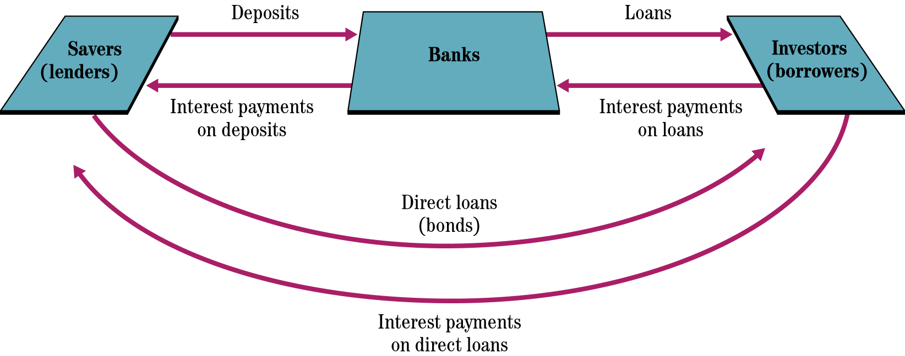
Channeling Funds from Savers to Investors

Slide 8
2. The Fed and the Banks: Creators of Money
2a. Banks and other financial intermediaries are involved in the translation of the funds of savers into an asset sold to investors or borrowers. Bank liabilities, such as deposits are loaned to borrowers, creating assets, such as loans. The basic balance sheet of a commercial bank is given in the next slide.
For example, a deposit account is an asset for the customer but a liability for the bank, while a customer's auto loan is a liability for the customer but an asset for the bank.

Slide 9
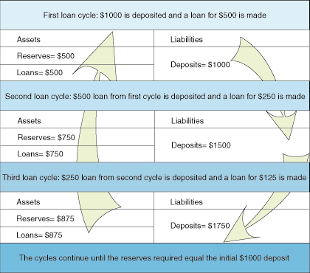

Slide 10
2. The Fed and the Banks: Creators of Money
2b. The Federal Reserve System is structured under the Federal Reserve Act of1913.
2b.1 Under this act, the overall supervision of the Fed rests with a seven-person Board of Governors, appointed for fourteen-year terms. A chairman is appointed by the president for a four-year term that is renewable; most chairmen serve more than four years. The board is responsible for monetary policy as well as the regulation and supervision of certain aspects of banking.

Slide 11
2. The Fed and the Banks: Creators of Money
2b.2 The twelve district banks carry out a number of tasks related to the money supply process, banking regulation and supervision, and the analysis of economic conditions in their region. In addition the presidents of the district banks participate in the formulation of monetary policy. The geographical distribution of Fed districts is given in Figure 22.2.

Slide 12
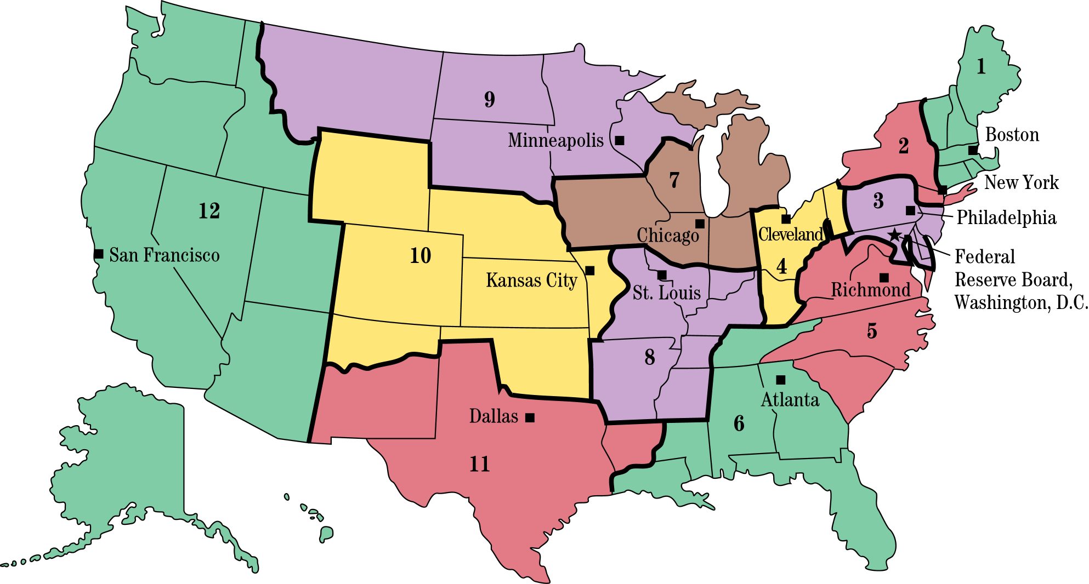
Figure 22.2 The Twelve Districts of the Fed

Slide 13
2. The Fed and the Banks: Creators of Money
2b.3 The Federal Open Market Committee (FOMC) consists of the seven governors and twelve district bank presidents, five of whom have votes on the committee. The chairman is the most powerful member of the FOMC, and his influence is so extensive that he is viewed by many as the second most powerful person in America. The relationship among the board, the district banks, and the FOMC is summarized in Figure 22.3.

Slide 14
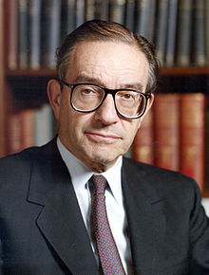
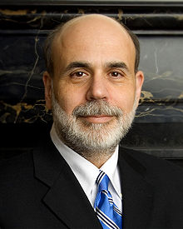
Chairman of the Federal Reserve System
Ben Bernanke
Incumbent since 2006
August 11, 1987 – January 31, 2006
Alan Greenspan

Slide 15
Figure 22.3 The Structure of the Fed

Slide 16
(1) The Classical Theory of Inflation
0
Notes:
16

Slide 17
The Value of Money
0
P = the price level (e.g., the CPI or GDP deflator)
P is the price of a basket of goods, measured in money.
1/P is the value of $1, measured in goods.
Example: basket contains one candy bar.
If P = $2, value of $1 is 1/2 candy bar
If P = $3, value of $1 is 1/3 candy bar
Inflation drives up prices and drives down the value of money.
Notes:
17

Slide 18
The Quantity Theory of Money
0
Developed by 18th century philosopher David Hume and the classical economists
Advocated more recently by Milton Friedman
Asserts that the quantity of money determines the value of money
We study this theory using two approaches:
A supply-demand diagram
An equation
Notes:
18

Slide 19
Money Supply (MS)
0
In real world, determined by the Central Bank (e.g., the Fed), the banking system, consumers.
In this model, we assume the Fed precisely controls MS and sets it at some fixed amount.
Notes:
19

Slide 20
Money Demand (MD)
0
Refers to how much wealth people want to hold in liquid form.
Depends on P: An increase in P reduces the value of money, so more money is required to buy goods & services.
Thus, quantity of money demanded is negatively related to the value of money and positively related to P, other things equal.
(These “other things” include real income, interest rates, availability of ATMs.)
Notes:
20

Slide 21
The Money Supply-Demand Diagram
0
Value of Money, 1/P
Price Level, P
As the value of money rises, the price level falls.
1
1
¾
1.33
½
2
¼
4
Quantity of Money
Notes:
21

Slide 22
The Money Supply-Demand Diagram
0
Value of Money, 1/P
Price Level, P
MS₁
1
1
¾
1.33
The Fed sets MS at some fixed value, regardless of P.
½
2
¼
4
$1000
Quantity of Money
Notes:
22

Slide 23
The Money Supply-Demand Diagram
0
Value of Money, 1/P
A fall in value of money (or increase in P) increases the quantity of money demanded:
Price Level, P
1
1
¾
1.33
½
2
¼
4
MD₁
Quantity of Money
Notes:
23

Slide 24
The Money Supply-Demand Diagram
0
Value of Money, 1/P
P adjusts to equate quantity of money demanded with money supply.
Price Level, P
MS₁
1
1
¾
1.33
eq’m value of money
eq’m price level
A
½
2
¼
4
MD₁
$1000
Quantity of Money
Notes:
24

Slide 25
The Effects of a Monetary Injection
0
Value of Money, 1/P
Price Level, P
MS₁
MS₂
Suppose the Fed increases the money supply.
1
1
Then the value of money falls, and P rises.
¾
1.33
A
½
2
eq’m value of money
eq’m price level
B
¼
4
MD₁
$1000
$2000
Quantity of Money
Notes:
25

Slide 26
A Brief Look at the Adjustment Process
0
Result from graph: Increasing MS causes P to rise.
How does this work?
At the initial P, an increase in MS causes excess supply of money.
People get rid of their excess money by spending it on g&s or by loaning it to others, who spend it. Result: increased demand for goods.
But (long-run) supply of goods does not increase, so prices must rise.
(Other things happen in the short run, which we will study in later chapters.)
Notes:
26

Slide 27
Fiat Currency vs Gold Standard.
http://www.youtube.com/watch?v=7uRw8HPwGYY

Slide 28
Real vs. Nominal Variables
0
Nominal variables are measured in monetary units.
Examples: nominal GDP, nominal interest rate (rate of return measured in $) nominal wage ($ per hour worked)
Real variables are measured in physical units.
Examples: real GDP, real interest rate (measured in output) real wage (measured in output)
Notes:
28

Slide 29
Real vs. Nominal Variables
0
Prices are normally measured in terms of money.
Price of a compact disc: $15/cd
Price of a pepperoni pizza: $10/pizza
A relative price is the price of one good relative to (divided by) another:
Relative price of CDs in terms of pizza:
price of cd
$15/cd
=
= 1.5 pizzas per cd
price of pizza
$10/pizza
Relative prices are measured in physical units, so they are real variables.
Notes:
29

Slide 30
Real vs. Nominal Wage
0
An important relative price is the real wage:
W = nominal wage = price of labor, e.g., $15/hour
P = price level = price of g&s, e.g., $5/unit of output
Real wage is the price of labor relative to the price of output:
W
$15/hour
=
= 3 units of output per hour
P
$5/unit of output
Notes:
30

Slide 31
The Classical Dichotomy
0
Classical dichotomy: the theoretical separation of nominal and real variables
Hume and the classical economists suggested that in the long run, monetary developments affect nominal variables but not real variables.
If central bank doubles the money supply, Hume & classical thinkers contend
all nominal variables – including prices – will double.
all real variables – including relative prices – will remain unchanged.
Notes:
31

Slide 32
The Neutrality of Money
0
Monetary neutrality: the proposition that changes in the money supply do not affect real variables
Doubling money supply causes all nominal prices to double; what happens to relative prices?
Initially, relative price of cd in terms of pizza is
price of cd
$15/cd
=
= 1.5 pizzas per cd
price of pizza
$10/pizza
The relative price is unchanged.
After nominal prices double,
price of cd
$30/cd
=
= 1.5 pizzas per cd
price of pizza
$20/pizza
Notes:
32

Slide 33
Real vs. Nominal Variables
http://video.about.com/economics/The-Difference-Between-Nominal-and-Real-Variables.htm

Slide 34
The Neutrality of Money
0
Monetary neutrality: the proposition that changes in the money supply do not affect real variables
Similarly, the real wage W/P remains unchanged, so
quantity of labor supplied does not change
quantity of labor demanded does not change
total employment of labor does not change
The same applies to employment of capital and other resources.
Since employment of all resources is unchanged, total output is also unchanged by the money supply.
Notes:
34

Slide 35
The velocity of money
http://www.youtube.com/watch?v=h5LnUA43UHc

Slide 36
The Velocity of Money
0
Velocity of money: the rate at which money changes hands
Notation: P x Y = nominal GDP = (price level) x (real GDP)
M = money supply
V = velocity
Velocity formula:
P x Y
V =
M
Notes:
36

Slide 37
The Velocity of Money
0
P x Y
Velocity formula:
V =
M
Example with one good: pizza. In 2008,
Y = real GDP = 3000 pizzas
P = price level = price of pizza = $10
P x Y = nominal GDP = value of pizzas = $30,000
M = money supply = $10,000
V = velocity = $30,000/$10,000 = 3
The average dollar was used in 3 transactions.
Notes:
37

Slide 38
A C T I V E L E A R N I N G 1 Exercise
One good: corn.
The economy has enough labor, capital, and land to produce Y = 800 bushels of corn.
V is constant.
In 2008, MS = $2000, P = $5/bushel.
Compute nominal GDP and velocity in 2008.

Slide 39
A C T I V E L E A R N I N G 1 Answers
Given: Y = 800, V is constant, MS = $2000 and P = $5 in 2005.
Compute nominal GDP and velocity in 2008.
Nominal GDP = P x Y = $5 x 800 = $4000
P x Y
$4000
V =
=
= 2
M
$2000

Slide 40
Type of money | M0 | MB | M1 | M2 | M3 | MZM
Notes and coins in circulation (outside Federal Reserve Banks and the vaults of depository institutions) (currency) | ✓^{[8]} | ✓ | ✓ | ✓ | ✓ | ✓
Notes and coins in bank vaults (Vault Cash) |  | ✓
Federal Reserve Bank credit (required reserves and excess reserves not physically present in banks) |  | ✓
Traveler's checks of non-bank issuers |  |  | ✓ | ✓ | ✓ | ✓
Demand deposits |  |  | ✓ | ✓ | ✓ | ✓
Other checkable deposits (OCDs), which consist primarily of Negotiable Order of Withdrawal (NOW) accounts at depository institutions and credit union share draft accounts. |  |  | ✓ | ✓ | ✓ | ✓
Savings deposits |  |  |  | ✓ | ✓ | ✓
Time deposits less than $100,000 and money-market deposit accounts for individuals |  |  |  | ✓ | ✓
Large time deposits, institutional money market funds, short-term repurchase and other larger liquid assets |  |  |  |  | ✓
All money market funds |  |  |  |  |  | ✓

Slide 41
U.S. Nominal GDP, M2, and Velocity (1960=100) 1960-2007
0
Nominal GDP
M2
Velocity is fairly stable over time.
Velocity
Notes:
41

Slide 42
The Quantity Equation
0
P x Y
Velocity formula:
V =
M
Multiply both sides of formula by M:
M x V = P x Y
Called the quantity equation
Calculate the change in price to the following year
P x Y
P =
Y
New Price- Old Price
Inflation rate =
Old price
Notes:
42

Slide 43
The Quantity Theory in 5 Steps
0
Start with quantity equation: M x V = P x Y
1. V is stable.
2. So, a change in M causes nominal GDP (P x Y) to change by the same percentage.
3. A change in M does not affect Y: money is neutral, Y is determined by technology & resources
4. So, P changes by same percentage as P x Y and M.
5. Rapid money supply growth causes rapid inflation.
Notes:
43

Slide 44
A C T I V E L E A R N I N G 2 Exercise
One good: corn. The economy has enough labor, capital, and land to produce Y = 800 bushels of corn. V is constant. In 2008, MS = $2000, P = $5/bushel.
For 2009, the CB increases MS by 5%, to $2100.
a. Compute the 2009 values of nominal GDP and P. Compute the inflation rate for 2008-2009.
b. Suppose tech. progress causes Y to increase to 824 in 2009. Compute 2008-2009 inflation rate.

Slide 45
A C T I V E L E A R N I N G 2 Answers
0
Given: Y = 800, V is constant, MS = $2000 and P = $5 in 2008.
For 2009, the CB increases MS by 5%, to $2100.
a. Compute the 2009 values of nominal GDP and P. Compute the inflation rate for 2008-2009.
Nominal GDP = P x Y
= M x V (Quantity Eq’n)
= $2100 x 2 = $4200
P =
P x Y
=
$4200
= $5.25
Y
800
$5.25 – 5.00
Inflation rate =
= 5% (same as MS!)
5.00

Slide 46
A C T I V E L E A R N I N G 2 Answers
0
Given: Y = 800, V is constant, MS = $2000 and P = $5 in 2005.
For 2009, the CB increases MS by 5%, to $2100.
b. Suppose tech. progress causes Y to increase 3% in 2009, to 824. Compute 2008-2009 inflation rate.
First, use Quantity Eq’n to compute P:
M x V
$4200
P =
=
= $5.10
Y
824
$5.10 – 5.00
Inflation rate =
= 2%
5.00
46

Slide 47
A C T I V E L E A R N I N G 2 Summary and Lessons about the Quantity Theory of Money
If real GDP is constant, then inflation rate = money growth rate.
If real GDP is growing, then inflation rate < money growth rate.
The bottom line:
Economic growth increases # of transactions.
Some money growth is needed for these extra transactions.
Excessive money growth causes inflation.
47

Slide 48
HYPERINFLATION In Germany!
Ron Paul’s Summary-
Little Big Planet-

Slide 49
Hyperinflation
A period of abnormally high growth in the cost of living is a hyperinflation
Behind every hyperinflation is an extremely high rate of growth in money.
The German Hyperinflation, 1921-1923
Costs of rebuilding and reparations payments induced the Weimar government to print more money.
As the pace of money supply growth increased, so too did inflation.
At one point prices were rising by 41% per day
In 1921, a newspaper sold for 0.3 marks. By 1923, that same newspaper cost 70 million marks.
Inflation became a self-fulfilling prophecy as people rushed to make purchases as soon as they received any money.
Inflation only ended when confidence was restored in the value of the currency after the Rentenmark was issued
Pretty much just dropped nine zeros off a billion mark note, but the psychological effect mattered.

Slide 50
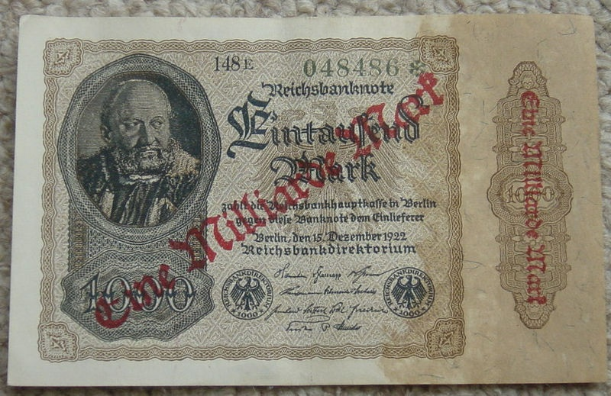
Hyperinflation
Overstamped as a million Mark note
1000 Mark Note
In Germany in 1923, prices were rising by 40% per day
$100 → $140 (1 day). $100 → $753 (1 week). $100 → $1.7 million (1 month)

Slide 51
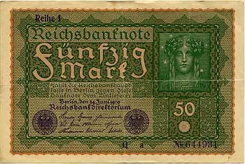
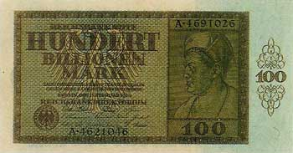
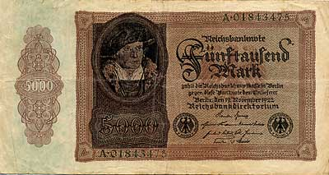
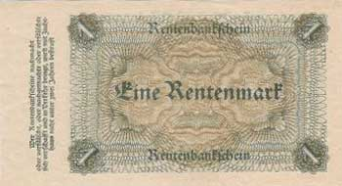
More from the German Hyperinflation
50 Marks, 1919
100 Billion Marks, 1924
5,000 Marks, 1922
1 Rentenmark, 1924

Slide 52
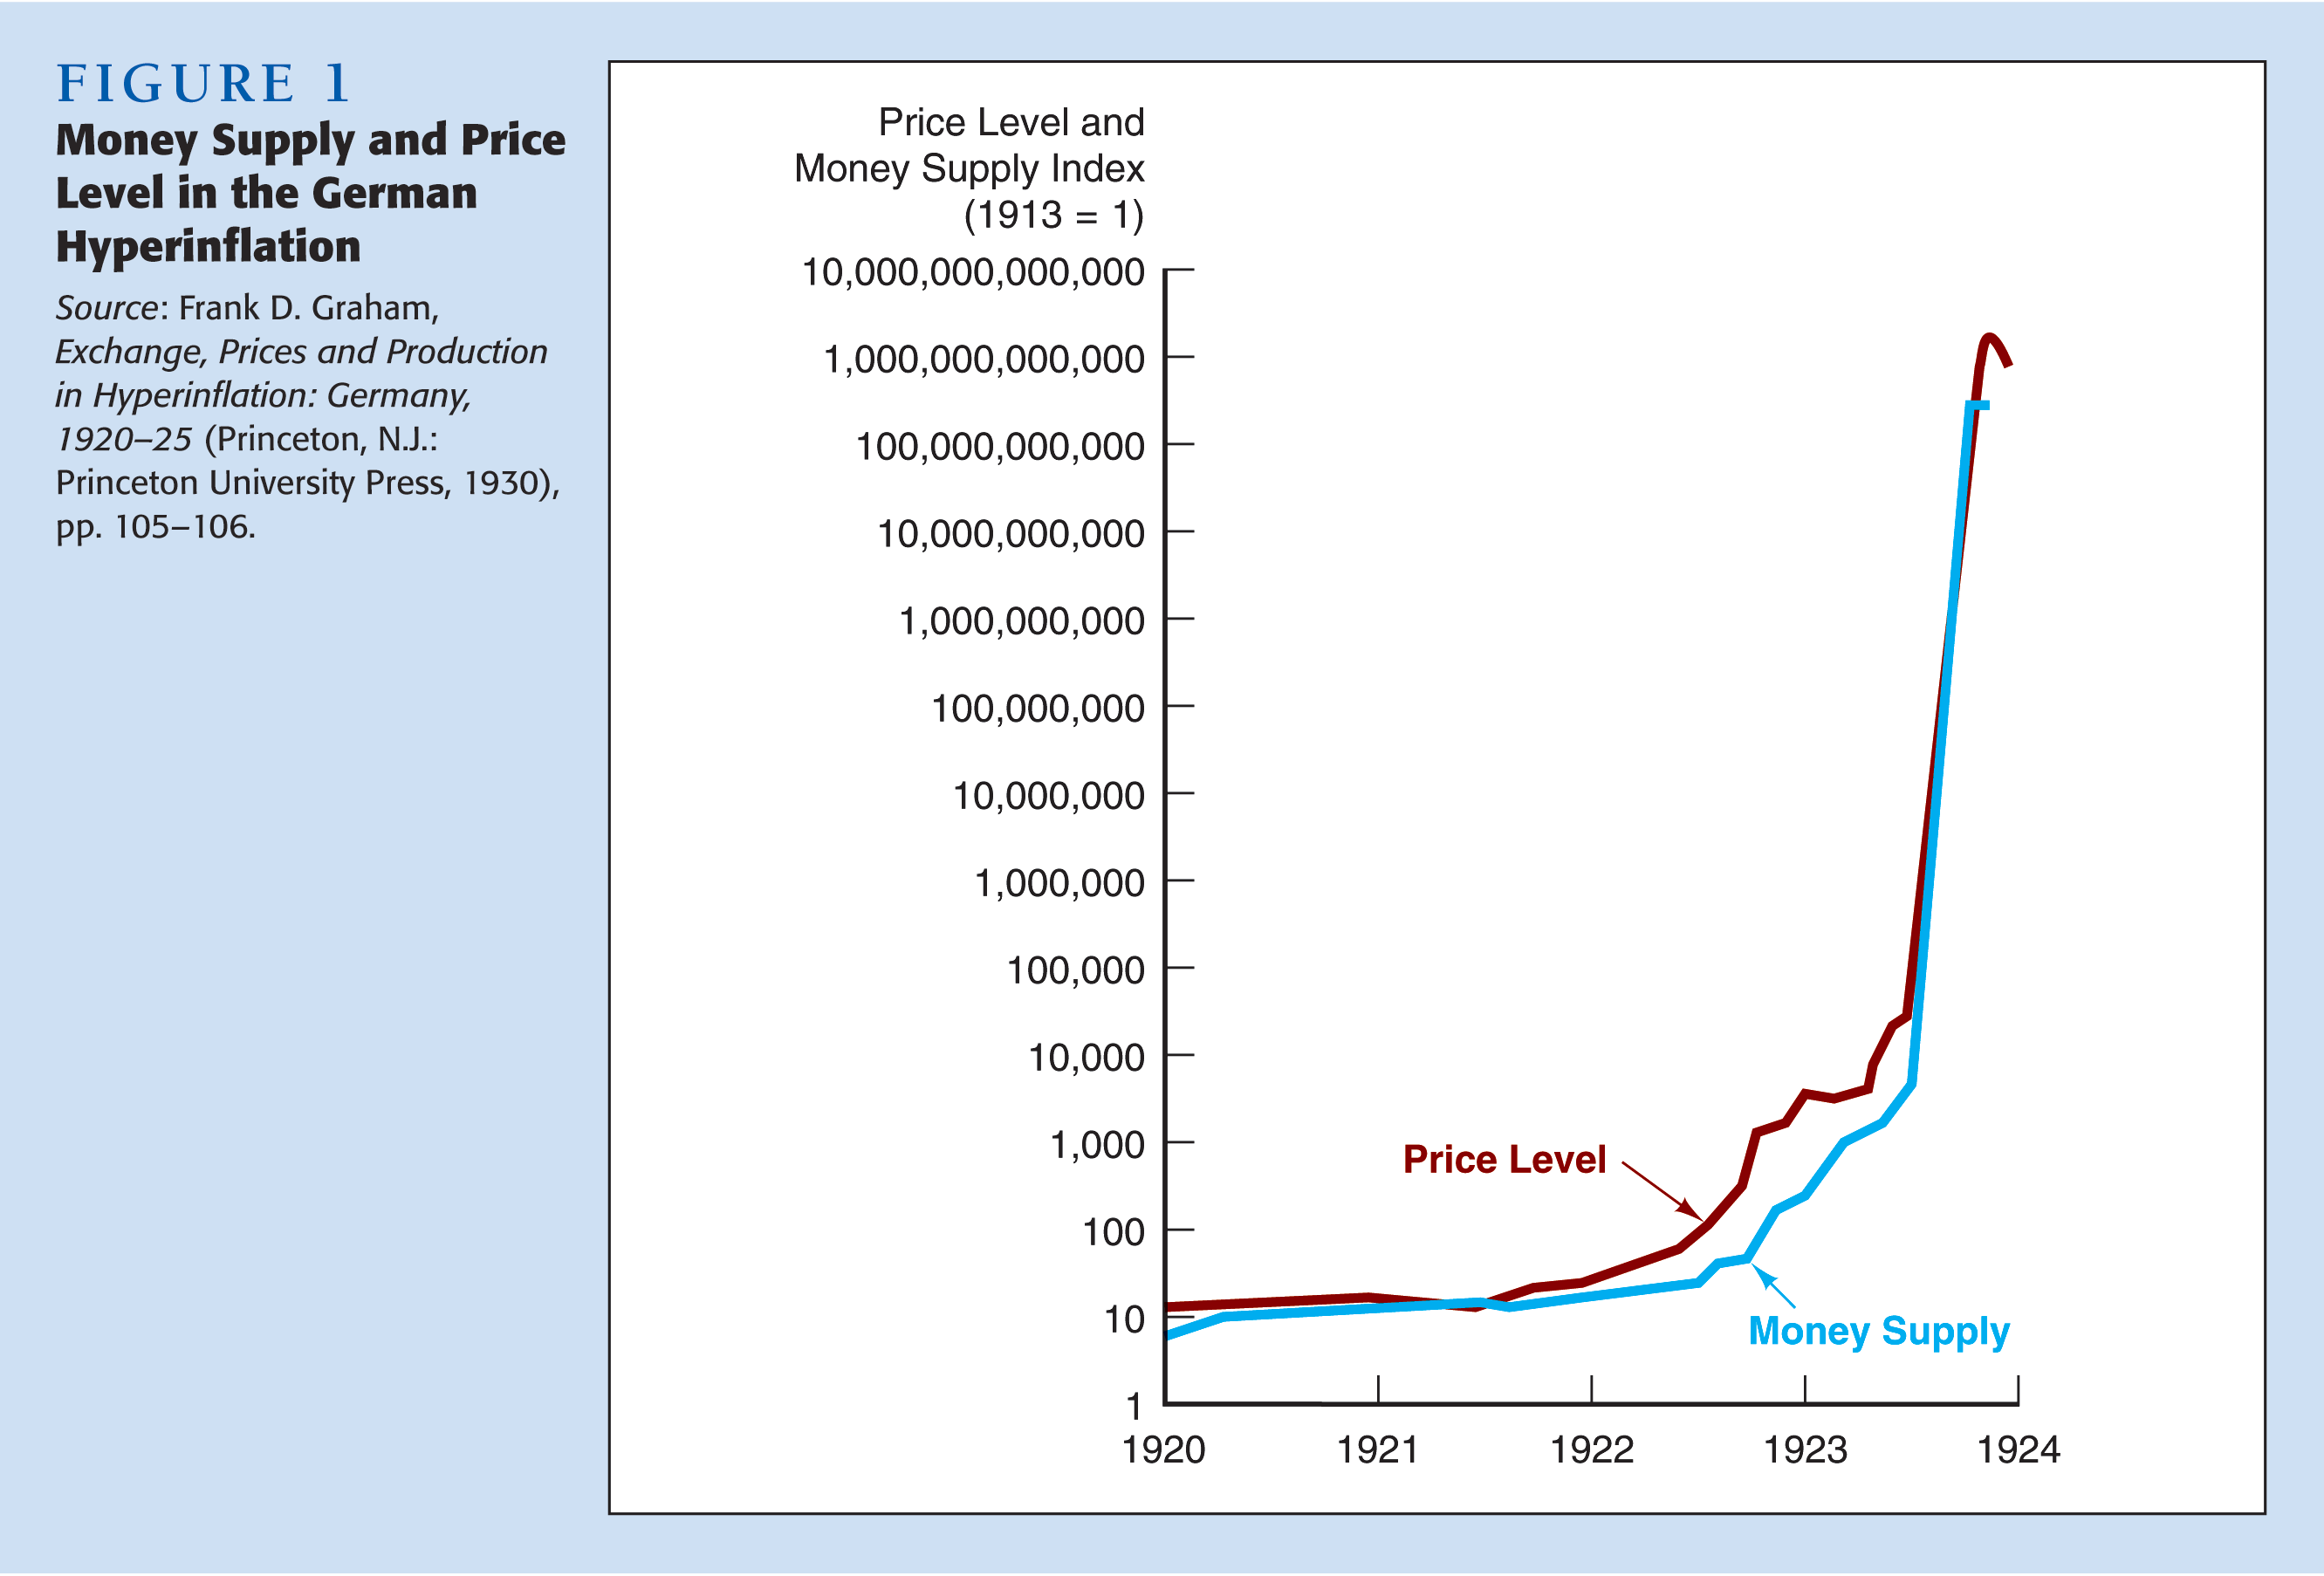
Money and Hyperinflation

Slide 53
Hyperinflations
Between August 1945 and July 1946, prices in Hungary rose by 19,000% per month. This translates into a 39% increase in prices every day
Bolivia in 1985 saw prices rise by 12,000%
One story tells of a man who did just this. On his payday, he received 50 million pesos, and a dollar cost 500,000 pesos (the exchange rate). He was able to exchange his pay for $50. A few days later, a dollar cost 900,000 pesos, and he would only have been able to get $27 for his efforts. The value of his wage had essentially been cut in half over the course of two days.
A less severe, but still high level of inflation occurred between 1970 and 1987 in Argentina, Bolivia, Brazil, Chile, Peru, and Uruguay, who collectively experienced an average annual inflation rate of 120%

Slide 54
The Inflation Tax
0
When tax revenue is inadequate and ability to borrow is limited, government may print money to pay for its spending.
Almost all hyperinflations start this way.
The revenue from printing money is the inflation tax: printing money causes inflation, which is like a tax on everyone who holds money.
In the U.S., the inflation tax today accounts for less than 3% of total revenue.
Notes:
54

Slide 55
The Fisher Effect
0
Rearrange the definition of the real interest rate:
Nominal interest rate
Inflation rate
Real interest rate
=
+
The real interest rate is determined by saving & investment in the loanable funds market.
Money supply growth determines inflation rate.
So, this equation shows how the nominal interest rate is determined.
Notes:
55

Slide 56
The Fisher Effect
0
Nominal interest rate
Inflation rate
Real interest rate
=
+
In the long run, money is neutral, so a change in the money growth rate affects the inflation rate but not the real interest rate.
So, the nominal interest rate adjusts one-for-one with changes in the inflation rate. (Long-run perspective)
This relationship is called the Fisher effect after Irving Fisher, who studied it.
Notes:
56

Slide 57
U.S. Nominal Interest & Inflation Rates, 1960-2007
0
The close relation between these variables is evidence for the Fisher effect.
57
Notes:
57

Slide 58
(2) The Costs of Inflation
0
Notes:
58

Slide 59
The Costs of Inflation
0
The inflation fallacy: most people think inflation erodes real incomes.
But inflation is a general increase in prices of the things people buy and the things they sell (e.g., their labor).
In the long run, real incomes are determined by real variables, not the inflation rate.
Notes:
59

Slide 60
U.S. Average Hourly Earnings & the CPI
0
Inflation causes the CPI and nominal wages to rise together over the long run.
Nominal wage (right scale)
CPI (left scale)
Notes:
60

Slide 61
The Costs of Inflation
0
(a) Shoeleather costs: the resources wasted when inflation encourages people to reduce their money holdings
Includes the time and transactions costs of more frequent bank withdrawals
(b) Menu costs: the costs of changing prices
Printing new menus, mailing new catalogs, etc.
Notes:
61

Slide 62
The Costs of Inflation
0
(c) Misallocation of resources from relative-price variability: Firms don’t raise prices frequently and don’t all raise prices at the same time, so relative prices can vary…
which distorts the allocation of resources.
(d) Confusion & inconvenience: Inflation changes the yardstick we use to measure transactions.
Complicates long-range planning and the comparison of dollar amounts over time.
Notes:
62

Slide 63
The Costs of Inflation
0
(e) Tax distortions:
Inflation makes nominal income grow faster than real income.
Taxes are based on nominal income, and some are not adjusted for inflation.
So, inflation causes people to pay more taxes even when their real incomes don’t increase.
Notes:
63

Slide 64
A C T I V E L E A R N I N G 3 Tax distortions
0
You deposit $1000 in the bank for one year.
CASE 1: inflation = 0%, nom. interest rate = 10%
CASE 2: inflation = 10%, nom. interest rate = 20%
a. In which case does the real value of your deposit grow the most?
Assume the tax rate is 25%.
b. In which case do you pay the most taxes?
c. Compute the after-tax nominal interest rate, then subtract off inflation to get the after-tax real interest rate for both cases.

Slide 65
A C T I V E L E A R N I N G 3 Answers
Deposit = $1000.
CASE 1: inflation = 0%, nom. interest rate = 10%
CASE 2: inflation = 10%, nom. interest rate = 20%
a. In which case does the real value of your deposit grow the most?
In both cases, the real interest rate is 10%, so the real value of the deposit grows 10% (before taxes).

Slide 66
A C T I V E L E A R N I N G 3 Answers
Deposit = $1000. Tax rate = 25%.
CASE 1: inflation = 0%, nom. interest rate = 10%
CASE 2: inflation = 10%, nom. interest rate = 20%
b. In which case do you pay the most taxes?
CASE 1: interest income = $100, so you pay $25 in taxes.
CASE 2: interest income = $200, so you pay $50 in taxes.

Slide 67
A C T I V E L E A R N I N G 3 Answers
Deposit = $1000. Tax rate = 25%.
CASE 1: inflation = 0%, nom. interest rate = 10%
CASE 2: inflation = 10%, nom. interest rate = 20%
c. Compute the after-tax nominal interest rate, then subtract off inflation to get the after-tax real interest rate for both cases.
CASE 1: nominal = 0.75 x 10% = 7.5%
real = 7.5% – 0% = 7.5%
CASE 2: nominal = 0.75 x 20% = 15%
real = 15% – 10% = 5%

Slide 68
A C T I V E L E A R N I N G 3 Summary and lessons
Deposit = $1000. Tax rate = 25%.
CASE 1: inflation = 0%, nom. interest rate = 10%
CASE 2: inflation = 10%, nom. interest rate = 20%
Inflation…
raises nominal interest rates (Fisher effect) but not real interest rates
increases savers’ tax burdens
lowers the after-tax real interest rate

Slide 69
A Special Cost of Unexpected Inflation
0
(f) Arbitrary redistributions of wealth Higher-than-expected inflation transfers purchasing power from creditors to debtors: Debtors get to repay their debt with dollars that aren’t worth as much.
Lower-than-expected inflation transfers purchasing power from debtors to creditors.
High inflation is more variable and less predictable than low inflation.
So, these arbitrary redistributions are frequent when inflation is high.
Notes:
69

Slide 70
The Costs of Inflation
0
All these costs are quite high for economies experiencing hyperinflation.
For economies with low inflation (< 10% per year), these costs are probably much smaller, though their exact size is open to debate.
Notes:
70

Slide 71
CONCLUSION
0
This chapter explains one of the Ten Principles of economics: Prices rise when the government prints too much money.
We saw that money is neutral in the long run, affecting only nominal variables.
In later chapters, we will see that money has important effects in the short run on real variables like output and employment.
Notes:
71

Slide 72
CHAPTER SUMMARY
To explain inflation in the long run, economists use the quantity theory of money. According to this theory, the price level depends on the quantity of money, and the inflation rate depends on the money growth rate.
The classical dichotomy is the division of variables into real & nominal. The neutrality of money is the idea that changes in the money supply affect nominal variables but not real ones. Most economists believe these ideas describe the economy in the long run.

Slide 73
CHAPTER SUMMARY
The inflation tax is the loss in the real value of people’s money holdings when the government causes inflation by printing money.
The Fisher effect is the one-for-one relation between changes in the inflation rate and changes in the nominal interest rate.
The costs of inflation include menu costs, shoeleather costs, confusion and inconvenience, distortions in relative prices and the allocation of resources, tax distortions, and arbitrary redistributions of wealth.

